Slide 1
From Prep to Plate - Plating the Vision
Project Phase Three Overview

Slide 2
Phase Three Overview
FRONT END: - Near finalization of UI and ensure functionality of all features
BACK END: - Continued work on the main engine, with focus on connecting to front end, and processing requests.
PROJECT MANAGEMENT: - Completed all necessary documents, including: Use Case, ERD, DFD, Quality Checklist.

Slide 3
Phase Three - Live Demo
Main Goal: MealMind is an AI-powered meal planning app that helps users cook smarter and waste less by generating tailored recipe suggestions and optimized grocery lists
Front End Live Demonstration
Logging in / landing page
Adding ingredients
Getting recipe recommendations
Viewing/editing grocery list

Slide 4
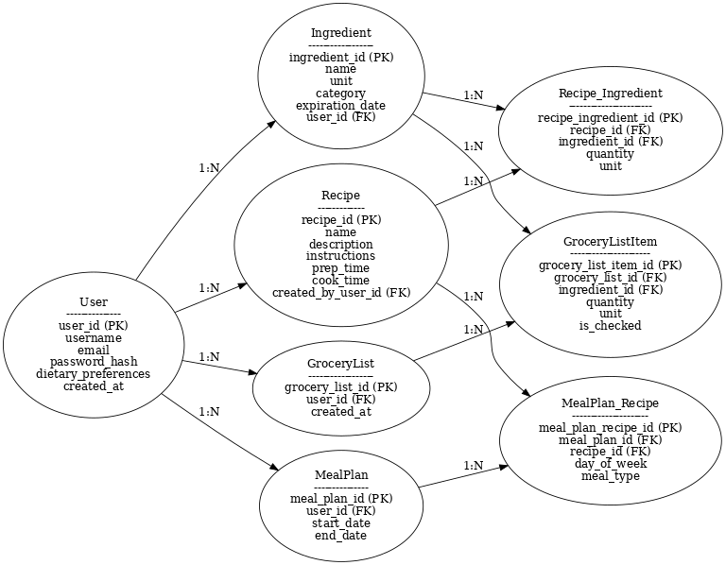
MealMind ERD

Slide 5
Front End Development
Frameworks used (e.g., React, HTML/CSS, etc.)
Overview of completed UI features:
Ingredient input
Recipe recommendations
Grocery list generation
Removed/unimplemented features (for transparency)

Slide 6
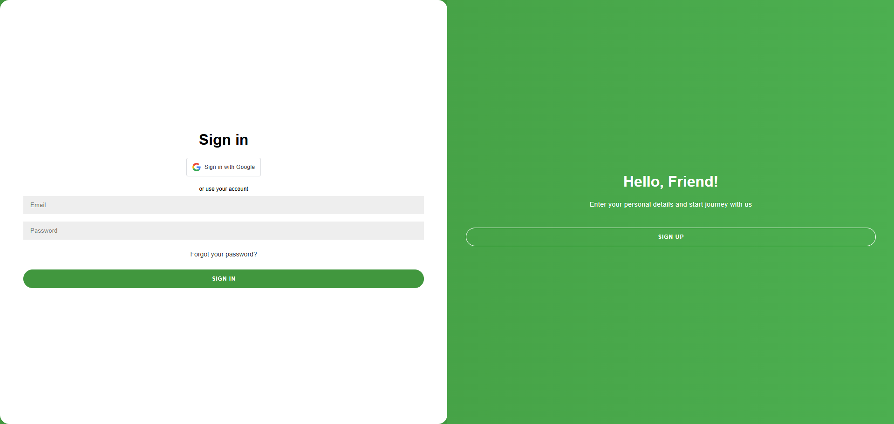
API, GoogleAPI, and other technology

Slide 7
Backend Development
Technologies used (e.g., Flask, Node.js, Firebase, etc.)
Server startup process & real-time handling of client requests
What our backend can do:
Accept user input from frontend
Trigger logic/AI for recipes
Return responses to the frontend

Slide 8
Server - Live Demo / Test
Show server start
Simulate client request
Watch the server respond

Slide 9
Challenges & Lessons Learned
Logic Complexity: Designing recipe selection logic to work with dynamic ingredients.
Client-Server Integration: Handling async requests, managing errors gracefully.
Data Modeling: Balancing normalization with performance.
Project Management: Prioritizing features within tight timeframes.
Key Takeaway: “Simple isn't easy — designing something user-friendly took more planning than expected.”

Slide 10
Quality Check and What’s Next?
Key quality items checked:
Functionality verified
UI/UX polished
Server-client integration confirmed Documentation submitted
Next steps for Phase 4 / Final Project:
Fine-tune features
Test extensively Final presentation polish

